Slide 1


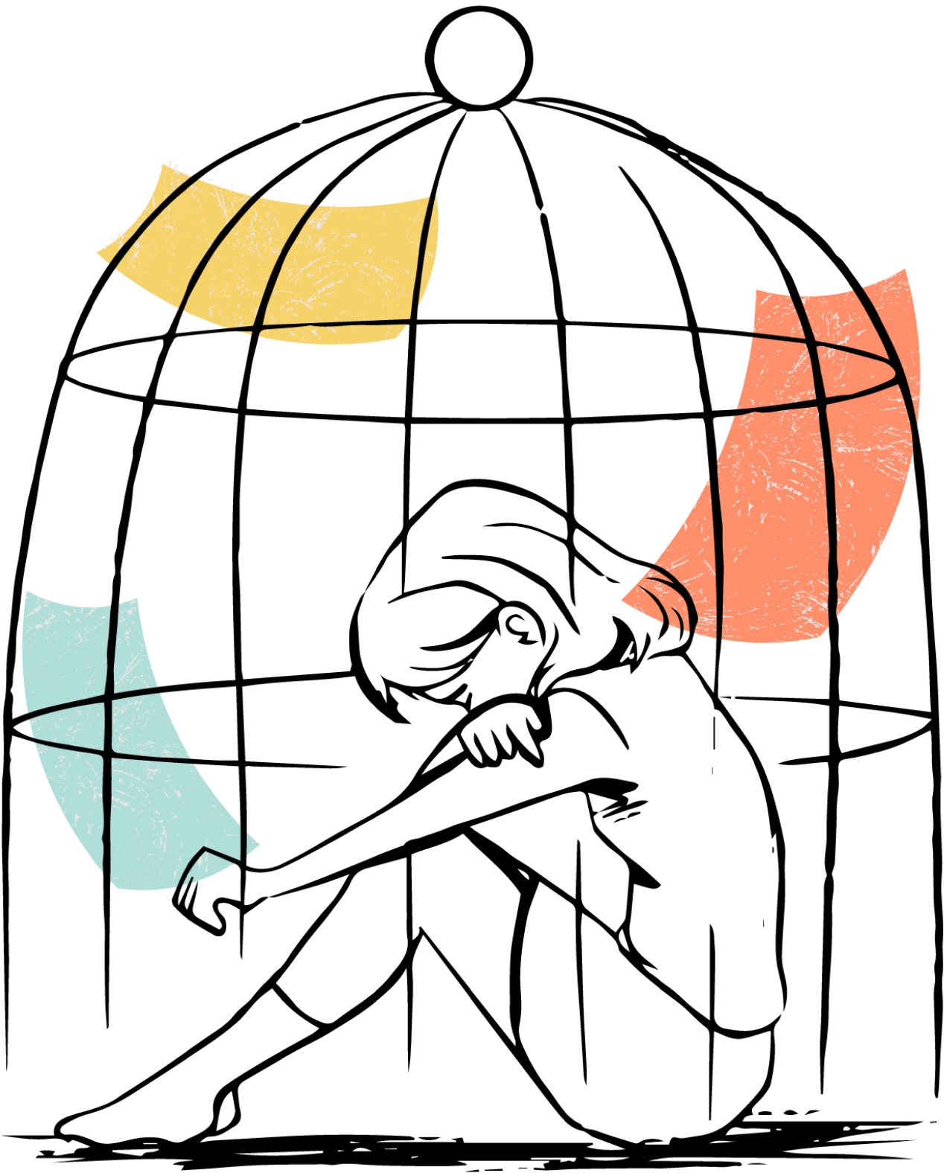
DEPARTMENT : COMPUTER SCIENCE ENGINEERING (ARTIFICIAL INTELLIGENCE AND MACHINE LEARNING)
GUIDED BY : Dr Geetha A
CRIMES AGAINST WOMEN
( 2001-2021)
By:
SANGEETHA E - 20221CAI0132
BHARGAVI U - 20221CAI0142
MONISHA S - 20221CAI0159
SINDHAMANI M -20231CAI3007
PRANATHI KRISHNA – 20231CAI3001

Slide 2
ABSTRACT
Analysis of crimes against women in India from 2001 to 2021 using a dataset of 736 entries across multiple states.
Categorization of crimes into types: Rape, Kidnap and Assault (K&A), Dowry Deaths (DD), Assault on Women (AoW), Assault on Minors (AoM), Domestic Violence (DV), and Women Trafficking (WT).
Visualization of trends and patterns through bar charts, pie charts, and line plots for insights into yearly and state-wise data.
Identification of states with high, medium, and low crime zones based on statistical thresholds.
Determination of the most prevalent crimes in each state and their distribution over time.
Highlighting the top and bottom 10 states in terms of total crimes reported.
Exploration of relationships between various crime types and state-level societal or administrative factors.

Slide 3
INTRODUCTION
Crimes against women remain a significant societal challenge worldwide, with far-reaching implications for individual security and public policy.
This study focuses on India, leveraging comprehensive data spanning 20 years to explore the scope and intensity of crimes against women.
By analyzing diverse crime types, the research sheds light on persistent issues and regional disparities, providing critical insights to policymakers and stakeholders.

Slide 4
Research Motivation
The alarming rise in reported crimes against women underscores the need for targeted intervention.
Data-driven approaches can offer a deeper understanding of underlying patterns, aiding prevention strategies.
Identification of high-crime zones can guide resource allocation for law enforcement and community programs.
Emphasis on longitudinal trends to understand the effectiveness of past measures and evolving challenges.
Objective
To perform a comprehensive analysis of crimes against women in India over two decades, identifying trends, patterns, and actionable insights.
Contributions
Categorization and detailed visualization of crime trends across different regions and time periods.
Identification of states with the highest and lowest crime rates and their specific vulnerabilities.
A framework for classifying states into crime zones (High, Medium, Low) based on statistical measures.
Highlighting of dominant crime types in each state, aiding targeted interventions.

Slide 5
LITERATURE SURVEY
Serial No. | Title | Methodology | Limitations
1 | Analysis of Crimes Against Women in India | Aggregated data (2001-2021) analyzed using statistical and visualization tools. | Lack of demographic breakdown and qualitative insights into cultural factors.
2 | Crime Zone Classification | Categorization of states into High, Medium, and Low zones based on crime data. | Threshold-based classification can overlook nuanced differences.
3 | Trend Analysis of Crime Types | Time series analysis of various crime categories. | Limited focus on policy changes or intervention effects over time.
4 | State-Level Comparative Analysis | Bar and pie chart visualizations of crime distribution across states. | Ineffective for understanding interdependence among crime types.

Slide 6
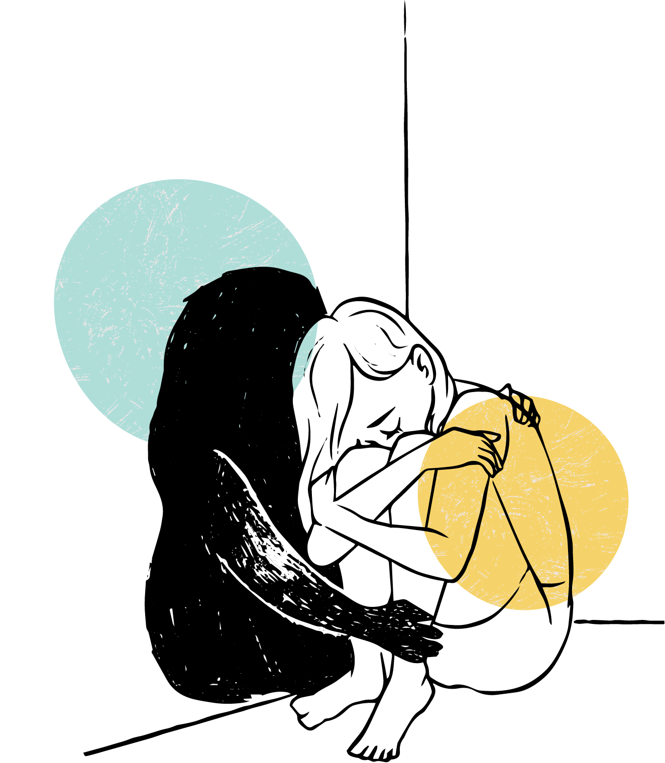
LIMITATIONS
Lack of qualitative insights: Current analyses are primarily quantitative, lacking integration with cultural and policy frameworks.
Static visualization: Focus on aggregated yearly and state data, with limited interactive or dynamic trend tracking.
Interdependencies: Minimal exploration of how different crime categories might correlate or influence each other.

Slide 7
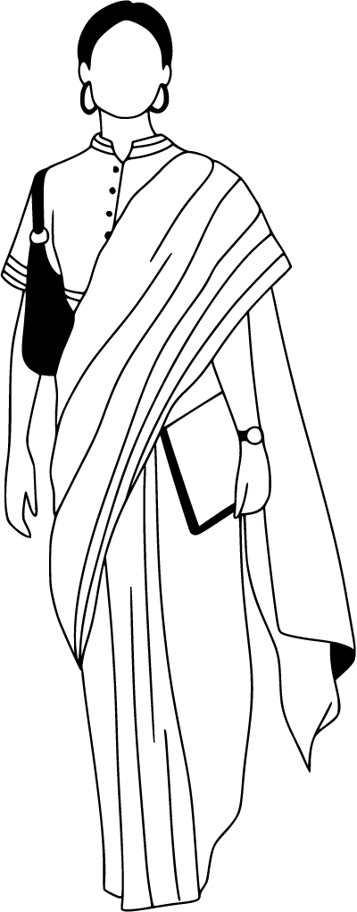
PROPOSED METHODOLOGIES
Enhanced Data Categorization: Introduce demographic features like age and education to enrich data insights.
Correlation Analysis: Use statistical techniques to explore interdependencies among crime types.
Policy Impact Studies: Integrate government intervention data to assess impacts over time.
Dynamic Dashboards: Develop interactive dashboards for real-time analysis and stakeholder engagement.
Geospatial Mapping: Incorporate geospatial analysis to visualize crime data on maps for spatial insights.

Slide 8
CONCLUSION
The comprehensive analysis of crimes against women in India highlights the persistent challenges and disparities in addressing such crimes. Visualizations such as trend lines, pie charts, and bar plots reveal critical insights into state-specific vulnerabilities and nationwide patterns. This study underscores the importance of data-driven policymaking to ensure targeted interventions.

Slide 9
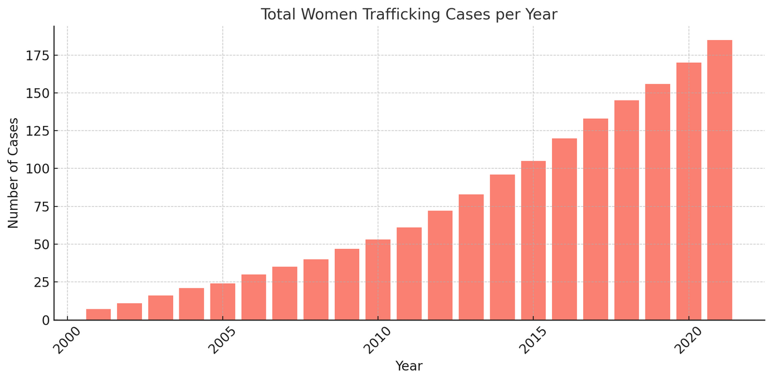
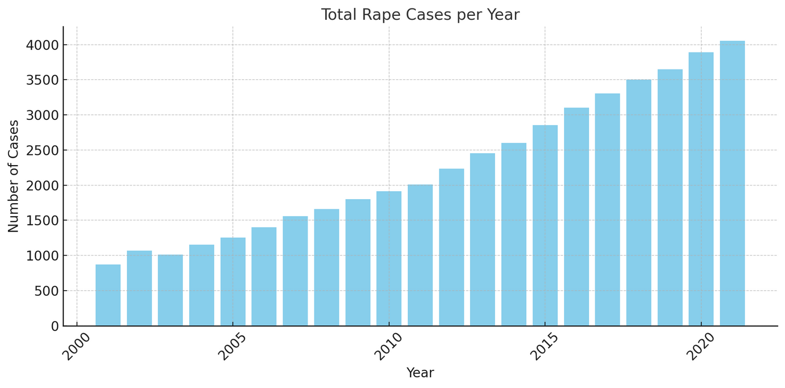
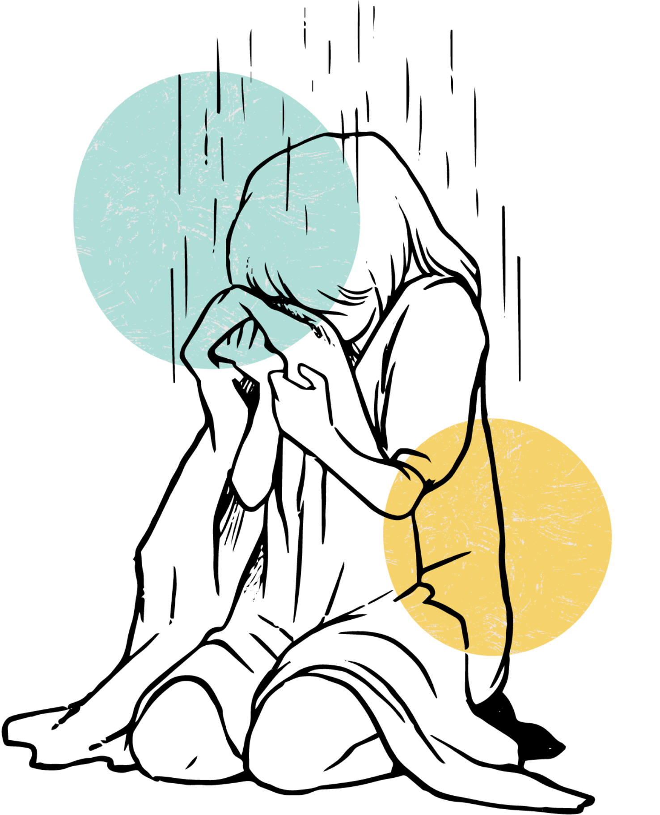

Slide 10
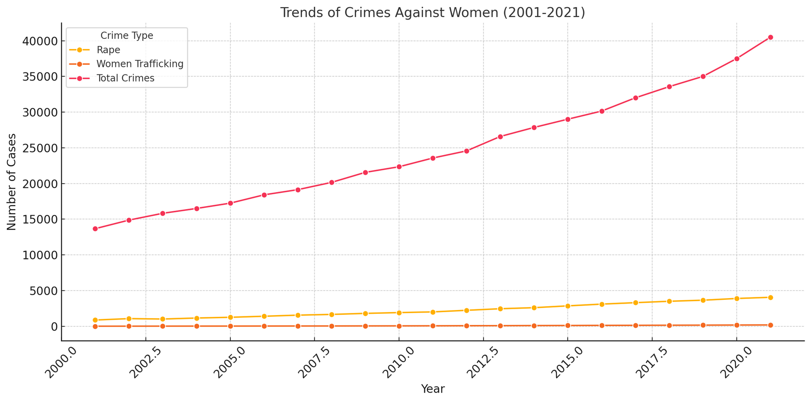

Slide 11
FUTURE ENHANCEMENT
Integration of Socio-Economic Indicators: Expand data attributes to include variables like literacy rates, income levels, and urbanization.
Predictive Analytics: Use machine learning to forecast crime trends and potential hotspots.
Impact of Policies: Conduct longitudinal studies to analyze the efficacy of laws and government interventions over time.
Focus on Prevention Strategies: Propose preventive measures based on crime patterns (e.g., awareness programs in high-crime zones).

Slide 12
REFERENCE
National Crime Records Bureau (NCRB)- (2021). Crime in India Report 2021. Ministry of Home Affairs, Government of India.
Ministry of Women and Child Development, Government of India- (2019). Report on Violence against Women in India.
Ganguly, S., & Chattopadhyay, P. (2020). "Understanding Domestic Violence in India: An Analysis of Key Factors". Journal of Indian Sociology, 59(1), 112-128.
Sharma, P., & Singh, A-(2018). "Crime against Women in India: A Statistical Analysis”. International Journal of Criminal Justice Sciences, 13(1), 15-29.
Bureau of Police Research and Development (BPRD)- (2020). Annual Report 2020-21. Ministry of Home Affairs, Government of India.
Das, P., & Ghosh, S. (2019). "Women’s Safety in India: Challenges and Prospects". Gender Studies Journal, 7(2), 43-56.
India Today-(2022). "Women Trafficking and Its Impact: A National Crisis". India Today Special Report.
Rao, R -(2021). "Trends in Rape Cases in India: A Two-Decade Overview". Journal of Social Sciences.
United Nations Women- (2020). Progress of the World's Women: Families in a Changing World.
Kumar, S., & Singh, R- (2021). "Mapping Domestic Violence in India: Data Insights and Policy Suggestions". Asian Journal of Law and Social Sciences,

Slide 13

thank you

